Slide 1
Governance and Compliance
Cybersecurity
Lesson 22.3

Slide 2

Learning Objectives
By the end of today’s lesson, you will be able to:
1
Explain how organizations use policy and procedure to formalize standards of “right” and “wrong.”
2
Use governance frameworks to determine which policies an organization must develop.
3
Explain how business continuity planning and disaster recovery ensure business- and mission-critical functions in the event of a disruption.

Slide 3
Structure of the security organization and the importance of security culture.
Threat modeling and risk analysis.
Day 1
Day 2
Today
We will cover governance, compliance, and business continuity planning (BCP) and disaster recovery (DR).

Slide 4
Governance entails codifying and enforcing proper behavior and operations by establishing standards of “right” and “wrong.”

Slide 5
Compliance entails enforcing the policies in order to meet those standards.

Slide 6

Knowledge of governance, compliance, and BCP and DR is crucial context for all security professionals.
Most professional security work is mandated by governance policies and subject to compliance audits.
Notes:
Image source: shutterstock_664638928

Slide 7
Lesson Breakdown
Today’s lesson will cover the following topics:
01
Codifying rules with policy and procedures
02
Using governance frameworks to guide policy decisions
03
Audit and compliance
04
BCP and DR
05
Developing BCP and DR recommendations for an organization

Slide 8

Codifying Rules with
Policy and Procedures

Slide 9
‹#›

Slide 10

We began this week by developing a training plan to improve GeldCorp’s security culture by changing employee behavior.
Notes:
Image source: shutterstock_741647569

Slide 11
Policy and Framework
We developed training plans by setting goals and determining the steps necessary to achieve them.
The training plan prescribed a specific rule that employees should follow.
This rule is an example
of a policy—a course or
principle of action proposed by a business.
The goal of defining and implementing a new download policy was to reduce employee click- through rate to less than 5%.
For example,
“Do not click on
links in emails
leading outside the corporate intranet.”
In this case,
the rule specifies
a download policy.
In other words,
the business implemented a policy as a means of achieving a goal.

Slide 12
Policy and Framework
Policy | A rule that defines the “right” behavior.
Governance Framework | Defines the policies an organization must have in place.
Policies inform
standards for behavior
and operations.
Organizations must use these frameworks to
remain compliant with
federal regulations and industry standards.

Slide 13

Business Goals and Policy Implementation
Business goals often drive policy creation. The two main types of business goals are:
Internal/Volitional
External/Imposed
Targets that the business sets in its own interest
For example:
An organization might aim to reduce long-term security expenses to less than $400,000.
Targets that the business must hit because it will suffer consequences if it does not
For example:
The requirement that online merchants process all credit card transactions securely, or suffer legal penalties if a customer’s PII is breached.

Slide 14

Internal Objectives and Policy Example
An organization would hand this goal to the IT team, which would be responsible for determining how best to implement it.
GOAL
Reduce unauthorized root-level login incidents on Domain Controllers to 0.
One possible implementation:
Require all domain administrators to use strong passwords and create a new password every month.
Notes:
shutterstock_1611857425

Slide 15

Internal Objectives and Policy
Implementing a strong password policy might require that administrators create passwords with:
1
At least 16 characters.
2
At least one letter and one number.
3
At least one special character (', (, ], etc.).
4
No portion of the administrator’s username.
5
Required monthly updates.

Slide 16

This Policy Defines Clear Standards of Behavior
Administrators must follow very specific rules for their passwords. Their computers will also enforce these rules.
These rules are specifically designed to achieve the goal
of reducing the incidence of unauthorized root-level logins
on domain controllers to zero.
Notes:
Image Source: AdobeStock_101143687

Slide 17
Password Policy: Example Part 1
CONFIDENTIAL DOCUMENT
DATE: 5/17/2017
AUTHOR: Jane Author
DOMAIN ADMINISTRATOR PASSWORD POLICY
This document lays out a password policy for domain administrators.
PURPOSE
The purpose of implementing a domain administrator password policy is to reduce the incidence of unauthorized root-level logins on domain controllers.
The organization has prioritized this objective in the interest
of protecting the integrity and confidentiality of data on the corporate intranet.

Slide 18
Password Policy: Example
Part 2
CONFIDENTIAL DOCUMENT
POLICY DESCRIPTION
Domain administrators will be required to create a new strong password every month. This password MUST NOT include any substring of the domain administrator's username.
In addition, the password must include:
- At least 16 characters
- At least 1 letter and 1 number
- At least 1 special character (', ( , ], etc.)
For example, the following passwords are legal for the user guest:
- CloGyPTioNEntEDist5$
- coffee&Donuts975
- n0tparticularly!strong
The following password is illegal:
- gue1st12345678901342

Slide 19
Password Policy: Example
Part 3
CONFIDENTIAL DOCUMENT
ENFORCEMENT
All workstations on the corporate domain have been configured
to require administrators to adhere to the above password complexity constraints and refresh intervals. Non-compliant passwords will be rejected by the operating system.
MONITORING
All attempts to login as a domain administrator—both remote
and local—will be monitored.

Slide 20
Documenting company policies
In this activity, you will develop and document policies to help GeldCorp address its most critical threats.
20 minutes

Slide 22
‹#›

Slide 23
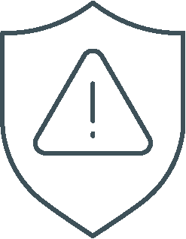
Managing Risk in IT Organizations

Slide 24

External Objectives and Policy
Businesses often have to follow external rules in addition to those they set for themselves. External rules don’t directly benefit the business, but might be mandated by law or industry standards.
Example:
Merchants that process financial transactions are legally required to guarantee that their customers’ data remains confidential.
If a company suffers a breach resulting
in the disclosure of customer PII, it may
be fined and face other legal penalties.
Notes:
shutterstock_1219092346

Slide 25
Governance frameworks are rules and policies that must be followed by everyone in an organization or industry.

Slide 26

Governance Frameworks
Internal
Developed by
the company
External
Developed by standards bodies
or governments

Slide 27
Governance Frameworks
As information security professionals, it is important to understand the distinctions between:
1
Policies
2
Guidelines
3
All of these will help guide your decision-making process in everything you do.
Laws
4
Regulations
5
Frameworks

Slide 28
A policy is a set of rules that inform standards for behavior and operations.

Slide 29
Policy Examples
Bring Your Own Device (BYOD)
Mobile Device Management (MDM)
This is a form of non-intrusive policy adopted by organizations that specifically define the acceptable use of non company-owned devices.
Devices referenced in this policy may include desktop computers, routers, switches, test measurement equipment, and weather equipment.
This is an example of a restrictive or intrusive policy that is a subset of a BYOD policy.
MDM is more specifically defined as an acceptable use policy of personally-owned mobile devices. Devices referenced in this policy include cell phones, laptops, and Wi-Fi hotspots.

Slide 30
Guidelines are similar to policies as they are issued by organizations to make the actions of employees or departments more predictable and presumably of a higher quality.

Slide 31
Guidelines are not mandatory. They are only suggestions meant to be followed by those to whom they apply.

Slide 32
Laws are policies that are written in legal language and voted upon and passed by legislative bodies of government.

Slide 33

Laws are enforced by agencies tasked with overseeing and monitoring the rule of law.
One such organization is the
US Securities and Exchange Commission (SEC).
Frameworks originate from the SEC, the regulatory organization in charge of proposing and enforcing laws regarding financial instruments
(e.g., stocks, bonds, options), and protecting consumers from fraud.

Slide 34
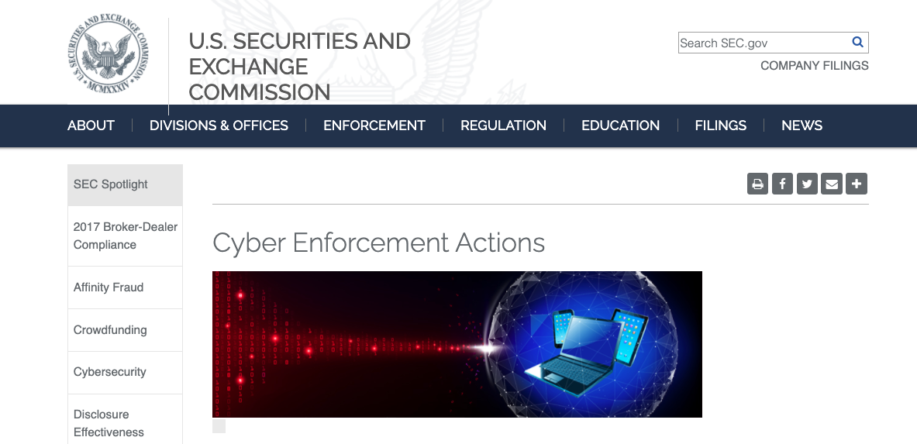
The SEC
During the 1990s, the SEC worked with the United States Congress to pass anti-fraud laws to discourage cybercrime. In 2000, the SEC moved past simple anti-fraud laws by adopting the regulatory statute Regulation S-P.
Source: sec.gov

Slide 35
Industry-Specific Laws
Different industries have different laws.
Gramm-Leach-
Bliley Act (GLBA)
Federal Information Security Management Act of 2002 (FISMA)
Health Insurance Portability and Accountability Act (HIPAA)
Family Educational Rights and Privacy Act (FERPA)
Protects the privacy
of student education records. Parents or eligible students have the right to request records be corrected
if they believe them
to be misleading or inaccurate.
Requires financial institutions that provide consumers with financial products and services to explain their information-sharing practices to safeguard sensitive data.
Requires the protection of government data, operations, and assets against natural or man-made threats.
Regulates the flow
of healthcare information and states how PII should be protected from misuse and theft within the healthcare industry.

Slide 36
Regulations are detailed instructions on how laws should be enforced.

Slide 37

Sometimes referred to as administrative laws, regulations are backed by the force of law, and their application is mandatory.
Legislative bodies pass laws and government agencies create regulations that implement the laws.
Notes:
shutterstock_650042977

Slide 38
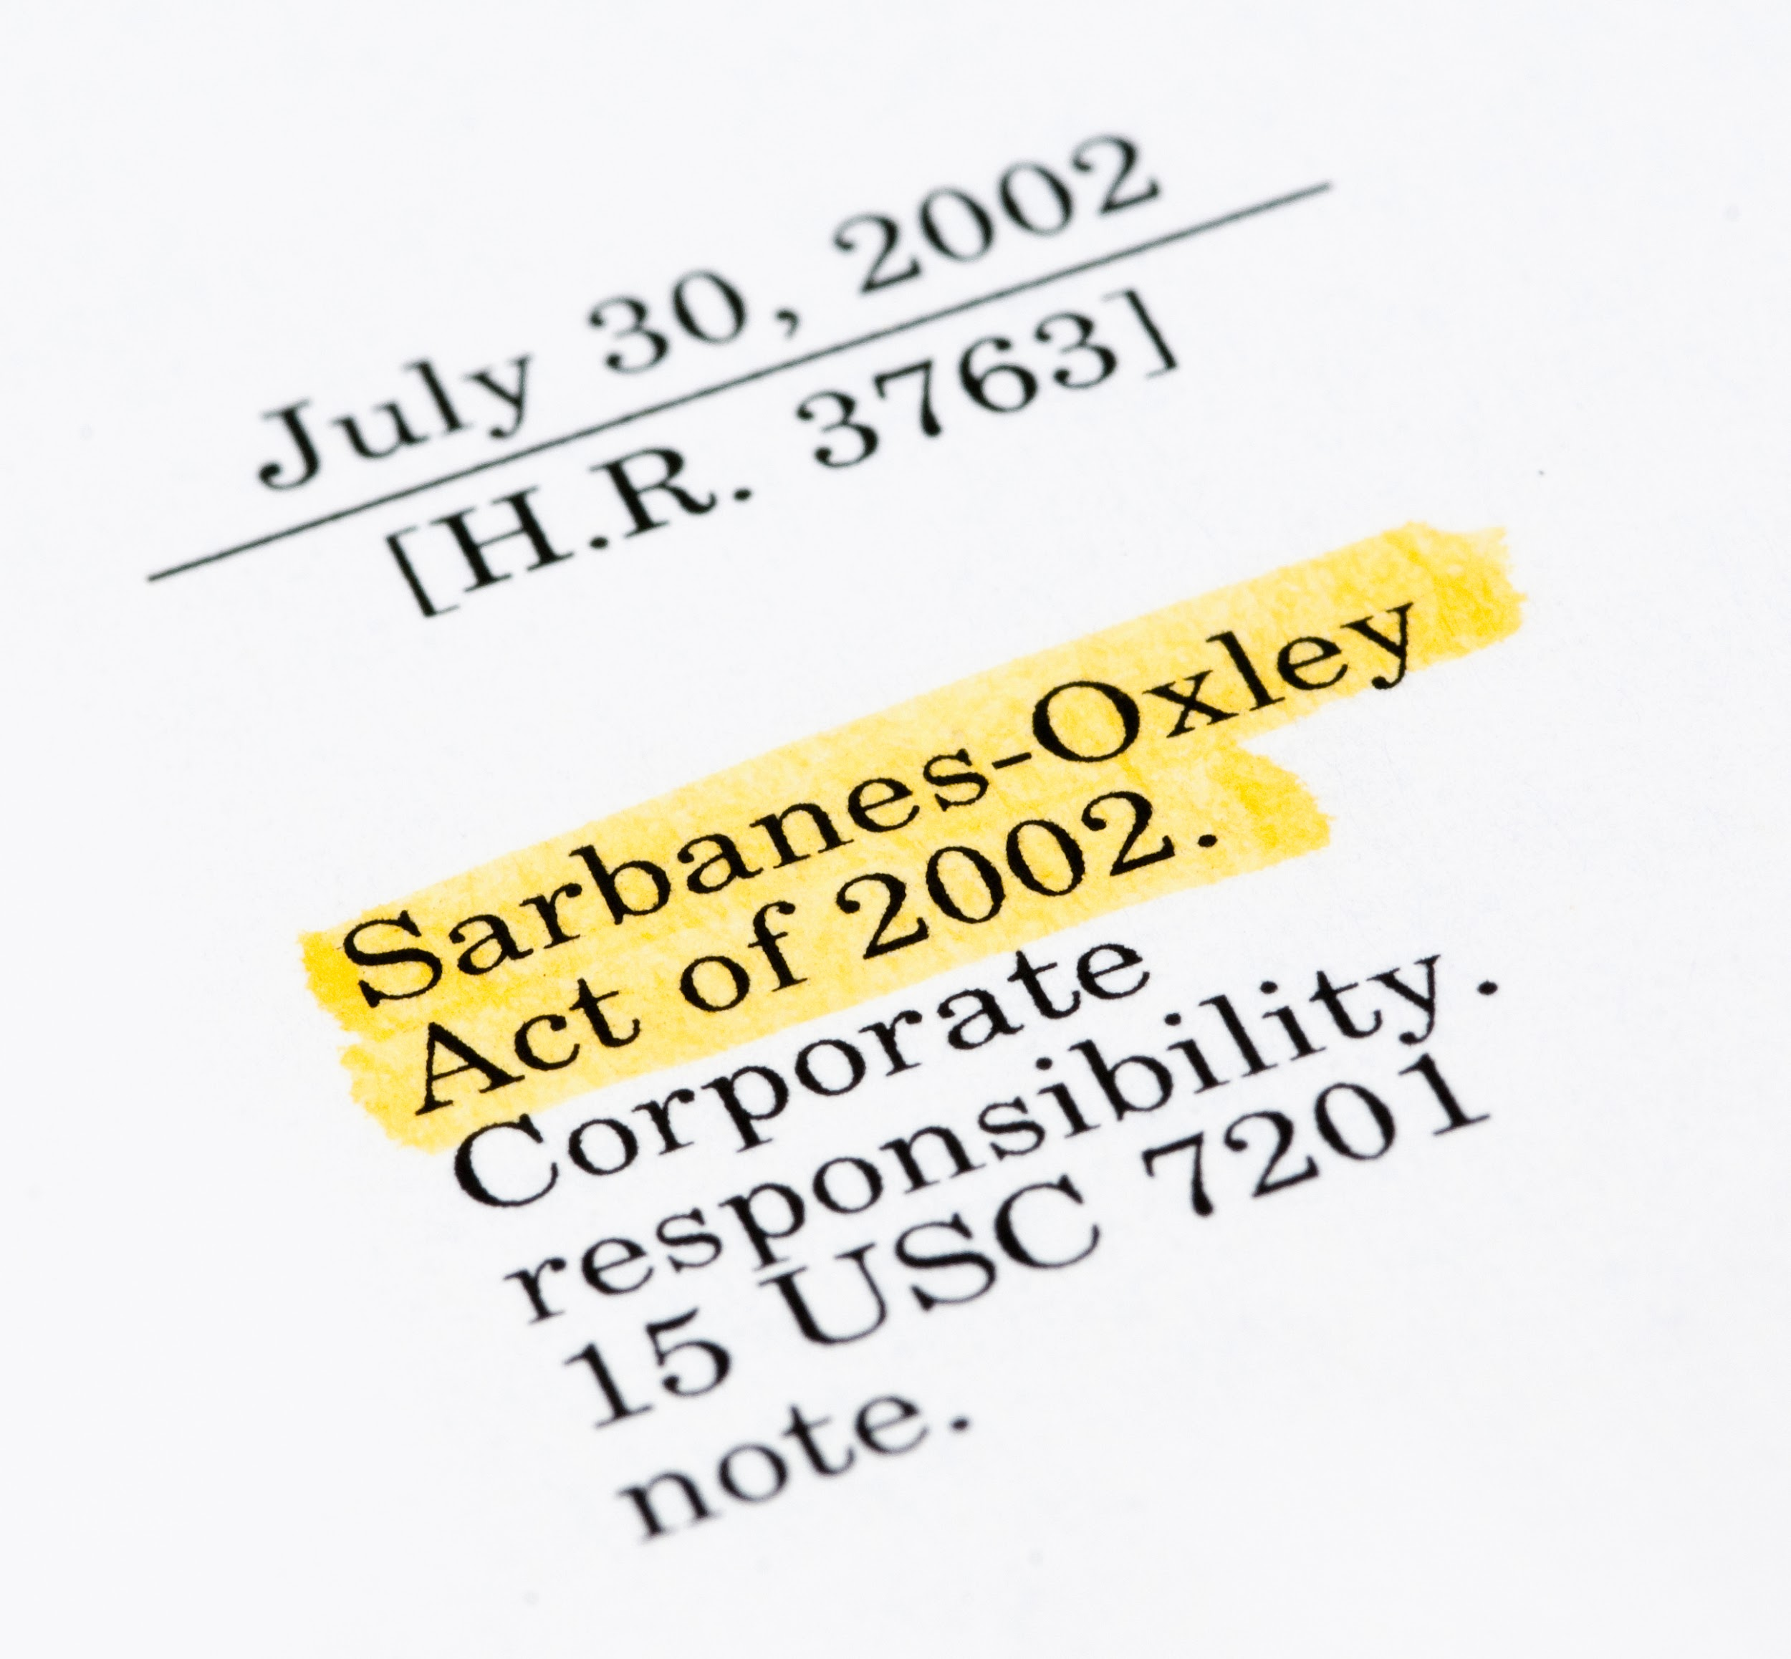
Regulations
Some of the more popular regulations
within information security include:
The Sarbanes-Oxley Act of 2002 (SOX), a result of the Enron and WorldCom scandal, holds corporate officers, board members, and executive management liable if the organization they represent is not compliant with the law.
Noncompliance includes negligence
and failure to implement any recommended precautions.
Due diligence and due care must be demonstrated at all times.
Notes:
shutterstock_155277629

Slide 39

Regulations
Some of the more popular regulations
within information security include:
The General Data Protection Regulation (GDPR)
protects the private data of all citizens of the European Union (EU) and European Economic Area (EEA).
Requires organizations that process
data belonging to EU citizens to protect
the data sufficiently.
GDPR regulations apply to organizations based in the EU as well as those based elsewhere that process data belonging
to EU citizens.
Notes:
shutterstock_1100645201

Slide 40
Standards are published specifications used to establish a common language and technical criteria across an organization or industry.

Slide 41

Standards Example
Merchants that process financial transactions are contractually required to comply with the Payment Card Industry Data Security Standard (PCI-DSS) to guarantee that their customers’ data remains confidential. If a company suffers a breach that results in the disclosure of customer PII, it may have to pay large fines and face other legal penalties.

Slide 42

Risk Management Frameworks
Properly implemented information security frameworks allow security professionals to intelligently manage cyber risks within their organizations.
Frameworks consist of various documents clearly defining adopted procedures, policies,
and processes that an organization must follow.
Having an information
security framework reduces
an organization’s risk and exposure to vulnerabilities.
Notes:
shutterstock_1105902953

Slide 43

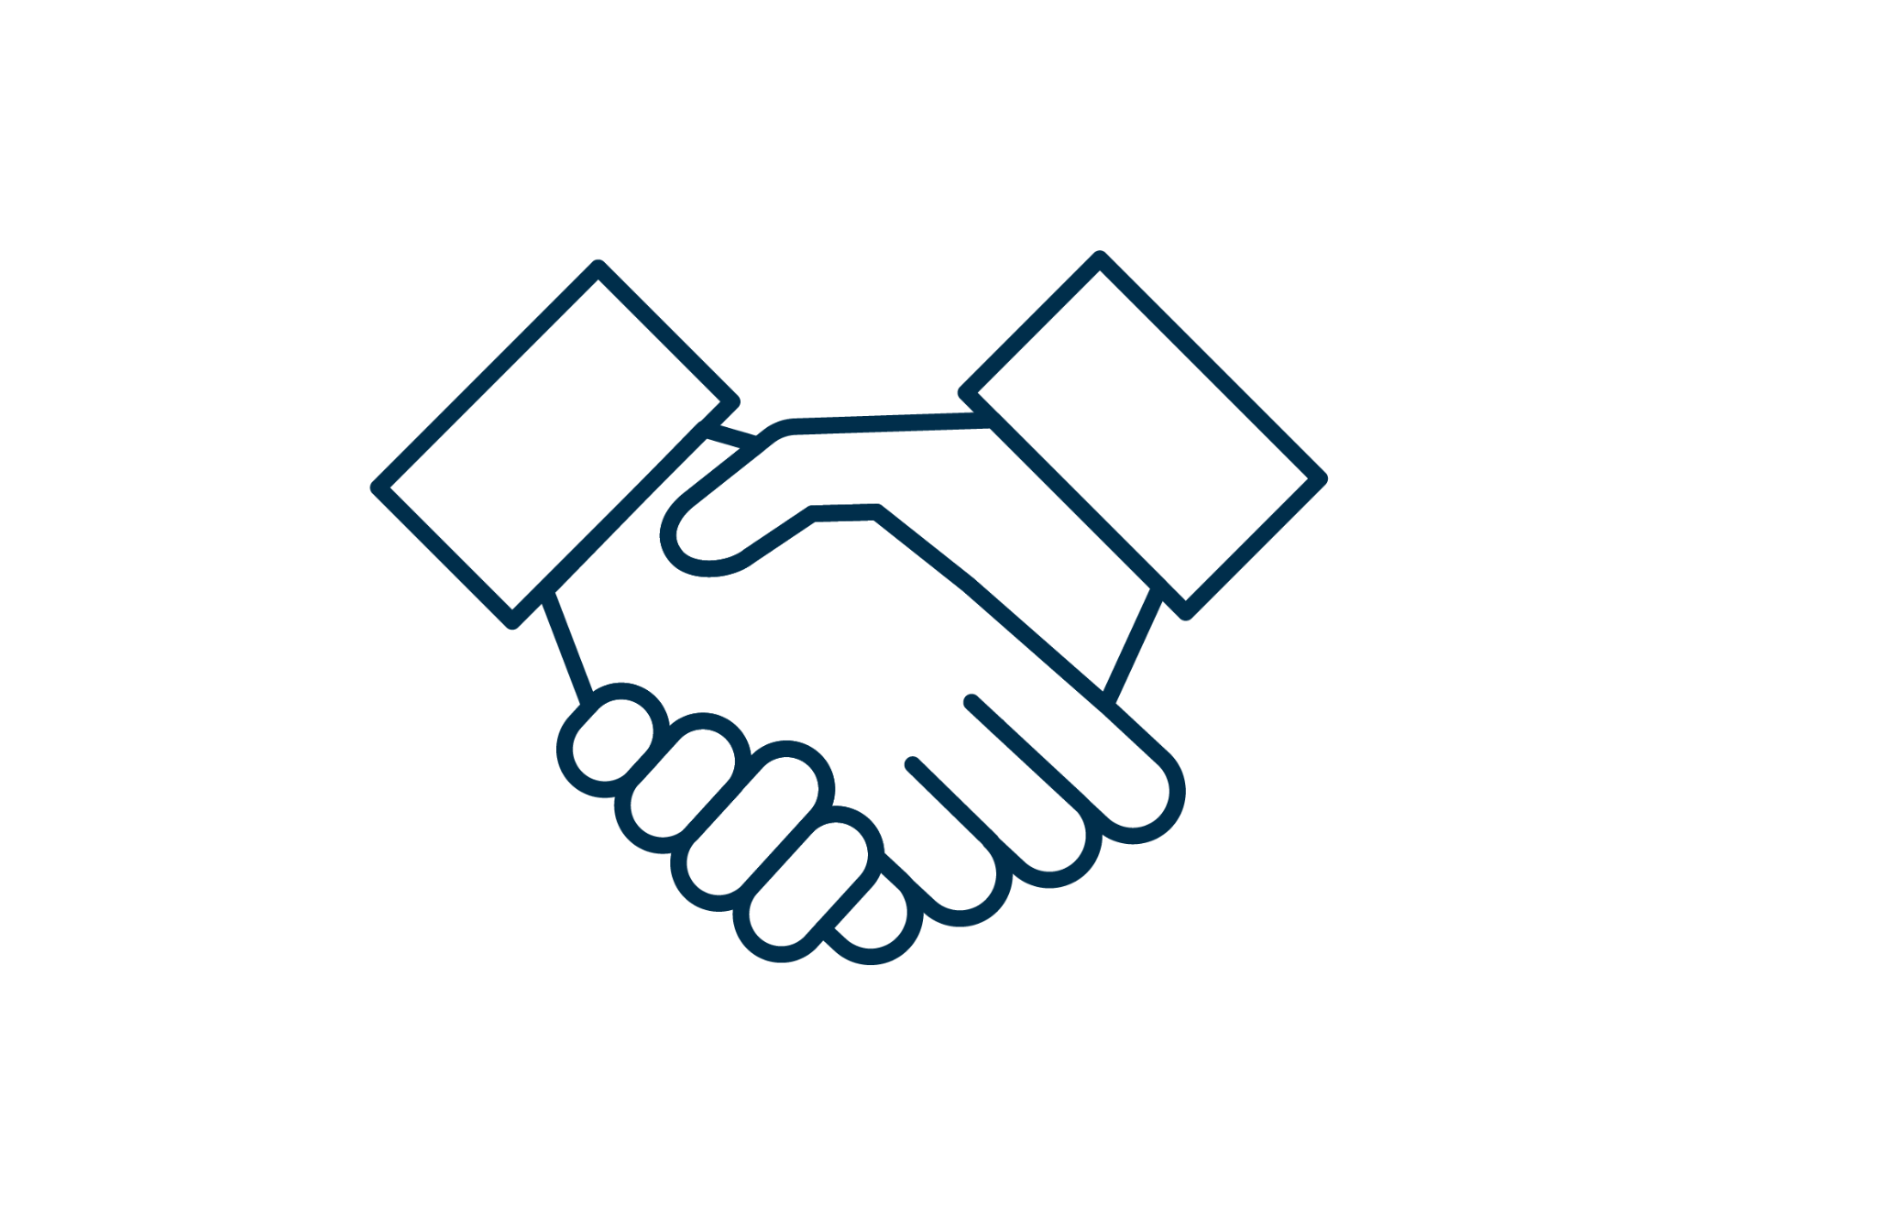

Risk Management Frameworks
Establishing a solid information security framework provides many advantages:
01
02
03
Instills confidence in your industry.
Establishes a strong reputation with business partners.
Provides a reputable relationship
with customers.
Notes:
shutterstock_1105902953

Slide 44
The Risk Management Framework (RMF) is a set of standards developed by the National Institute of Standards and Technology (NIST).

Slide 45
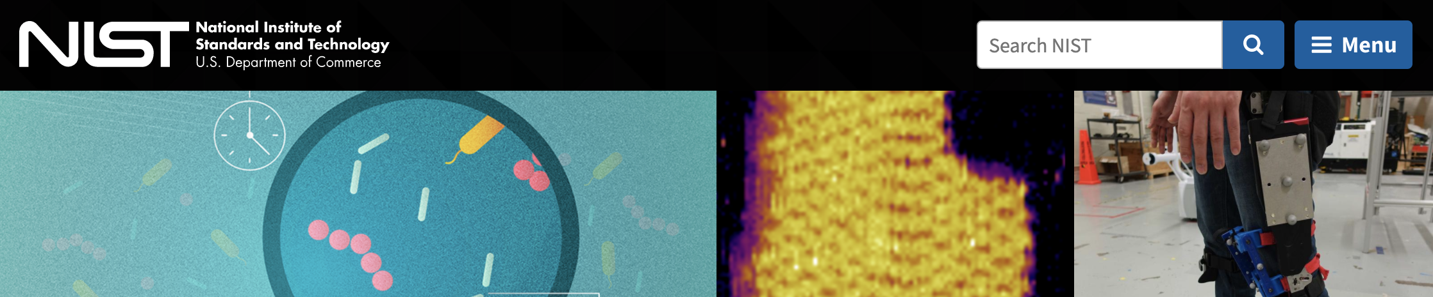
Risk Management Frameworks
Risk Management Framework for Information Systems and Organizations
Security and Privacy Controls for Federal Information Systems and Organizations
Describes NIST’s formal Risk Management Framework
certification and accreditation process.
Source: NIST Special Publication 800-37 Rev. 2
Describes a structured process for an organization to select system security controls and integrate them as part of their risk management program.
Source: NIST Special Publication 800-53 Rev. 5
Source: nist.gov

Slide 46

National Institute of Standards and Technology
NIST is a federal agency within the United States Department of Commerce.
NIST’s mission is to develop and promote standards, measurements, and technology that enhance productivity, facilitate trade, and improve quality of life.
Since 2014, the NIST Cybersecurity Framework (CSF) has provided guidance for critical infrastructure
so that organizations can better manage and reduce cybersecurity risks.

Slide 47
NIST Cybersecurity Framework
The NIST Cybersecurity Framework is made up of categories, subcategories, and informative resources.
Functions | Categories | Subcategories | Informative References
Identify
Protect
Detect
Respond
Recover

Slide 48
Let’s take a look at how an organization would implement the NIST Cybersecurity Framework.

Slide 49


NIST CSF Scenario
An organization has just recovered from an attack. It must now consider what it can do to mitigate this attack from happening again.
Solution
The organization decides to incorporate “lessons learned” as part of its incident response. It will adopt and incorporate a security control from the Improvements category of the NIST RMF with a subcategory of RS.IM-1.
Function | Category | Subcategory | CCS CSC | COBIT 5 | ISA 62443-2-1: 2009 | ISA 62443-3-3: 2013 | ISO/IEC 27001:2013 | NIST SP 800-53 REV. 4
RS | IM | IM-1 |  | BA101.13 | 4.3.4.5.10, 4.4.3.4 |  | A.16.1.6 | CP-2, IR-4, IR-8
Appendix A: Framework Core Informative References
Source: nist.gov
Notes:
shutterstock_287479460

Slide 50
NIST CSF Scenario
Improvements (RS.IM): Organizational response activities are improved by
incorporating lessons learned from current and previous detection and response activities.
RS.IM-1: Response plans incorporate lessons learned.
Function | Category | Subcategory | Informative Resources
Respond | Improvements (RS.IM): Organizational response activities are improved by incorporating lessons learned from current and previous detection and response activities. | RS.IM-1: Response plans incorporate lessons learned. | COBIT 5 BAI01.13 ISA 62443-2-1:2009 4.3.4.5.10, 4.4.3.4 ISO/IEC 27001:2013 A.16.1.6, Clause 10 NIST SP 800-53 Rev. 4 CP-2, IR-4, IR-8
 |  | RS.IM-2: Response strategies are updated. | COBIT 5 BAI01.13, DSS04.08 ISO/IEC 27001:2013 A.16.1.6, Clause 10 NIST SP 800-53 Rev. 4 CP-2, IR-4, IR-8
(nist.gov)

Slide 51
An RMF is a set of documents
that define best practices.
An organization may voluntarily follow these to efficiently manage its cybersecurity risks.

Slide 52
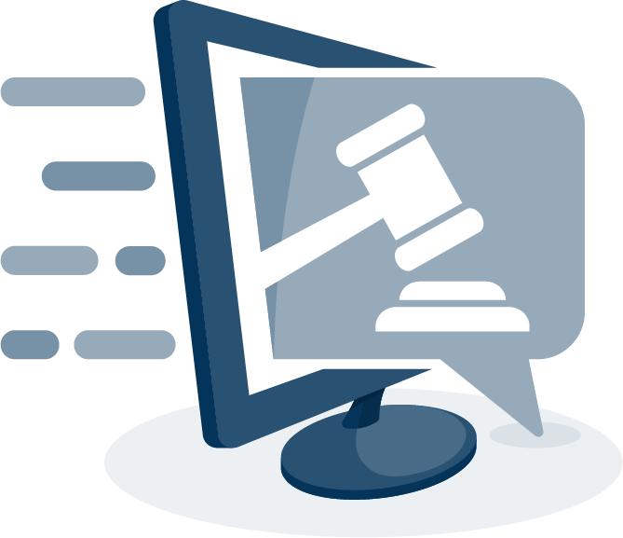
Setup for Next Activity
In the next activity, you will play the role of a security consultant for a new online auction company E-Auctions.com.
1
You are tasked with determining E-Auctions.com’s security posture before the business is launched.
2
You’ll accomplish this by conducting
an interview with the CEO of E-Auctions.com. Your instructor will play the role of the CEO.
3
As a class, you will each develop one question about E-Auctions.com's security posture and take turns interviewing the CEO.
Notes:
shutterstock_1177099138

Slide 53
Setup for Next Activity
You will be assigned a number between 1 and 22.
This number will correspond to a NIST category.
You will develop a question relevant to the NIST category you are assigned.
NIST documentation is provided so you can learn about your category and subcategories.
1 | Asset Management (ID.AM)
2 | Business Environment (ID.BE)
3 | Governance (ID.GV)
4 | Risk Assessment (ID.RA)
5 | Risk Management Strategy (ID.RM)
6 | Access Control (PR.AC)
7 | Awareness and Training (PR.AT)
8 | Data Security (PR.DS)
9 | Information Protection Processes and Procedures (PR.IP)
10 | Maintenance (PR.MA)
11 | Protective Technology (PR.PT)
12 | Anomalies and Events (DE.AE)
13 | Security Continuous Monitoring (DE.CM)
14 | Detection Processes (DE.DP)
15 | Response Planning (RS.RP)
16 | Communications (RS.CO)
17 | Analysis (RS.AN)
18 | Mitigation (RS.MI)
19 | Improvements (RS.IM)
20 | Recovery Planning (RC.RP)
21 | Improvements (RC.IM)
22 | Communications (RC.CO)

Slide 54
CEO interviews
In this activity, you will formulate a question and pose it to the CEO of E-Auctions.com.
10 minutes

Slide 55
Take turns asking your questions
Everyone Do: CEO Interview
Suggested Time
25 minutes

Slide 57
Notes:
Image source: AdobeStock_56885471

Slide 58
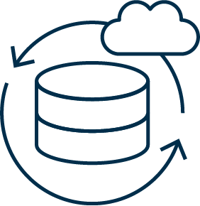
Business Continuity Planning (BCP)
and Disaster Recovery (DR)

Slide 59

All of the machinery of governance and compliance can’t guarantee that an organization will not experience
a security breach.
Businesses
must still have contingency plans in place to prepare for the worst.
Notes:
shutterstock_217638118

Slide 60
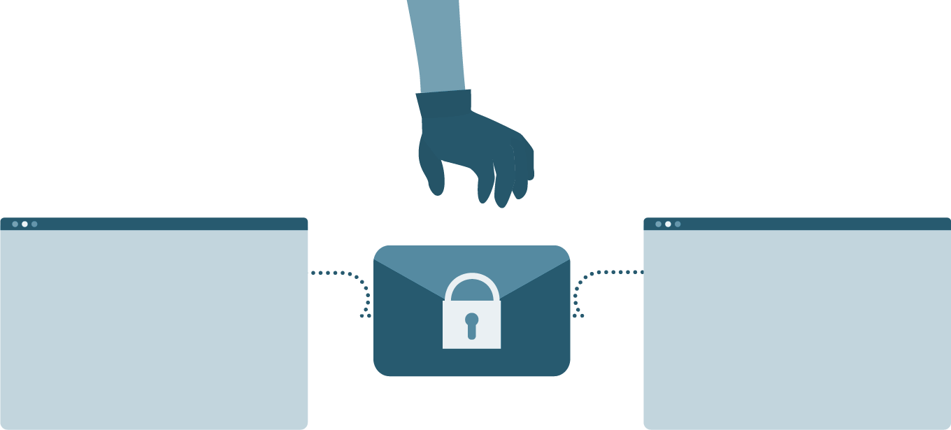
Contingency Planning for Business Continuity
A breach can have one of two results:
01
Mild or Moderate Breach
02
Serious or Catastrophic Breach
The business has been impacted, but can still handle day-to-day operations at greater cost.
The business has been impacted so severely that
it cannot operate. Instead,
it must use its resources to contain the incident, recover from the disaster, and eventually return to operations.
Notes:
shutterstock_1276712677

Slide 61

Security Concerns vs. Business Concerns
BCP and DR planning focus
on contingency plans in the event of a disruption or disaster, and ensure that the business can resume daily operations.
Notes:
shutterstock_1421998877

Slide 62
What are some possible disruptions or disasters?

Slide 63

Contingency Planning for Business Continuity
Cyberattacks
Human Error
Environmental Disasters
Notes:
Image sources: shutterstock_411741793, shutterstock_185621111, shutterstock_511910884

Slide 64
Business Continuity Planning vs. Disaster Recovery
It is important to note the differences between BCP and DR.
Business Continuity Planning
Disaster Recovery
Focuses on processes and procedures to ensure business critical functions continue
during and after a disaster.
Focuses on the specific steps
an organization must take to resume work after a disaster.

Slide 65
Business Continuity Planning and Disaster Recovery
BCP and DR both begin with a contingency planning policy and business impact analysis.
Strategies for high-impact loss should consider high availability and redundancy options. For example, fully redundant load-balanced systems at alternate sites, data mirroring, and offsite database replication.
High-availability options are normally expensive to set up, operate, and maintain and should be considered only for high-impact information systems categorized with a high-availability security objective.
Lower-impact information systems may be able to use less expensive contingency options and tolerate longer downtimes for recovery or restoration of data.

Slide 66
NIST Impact Levels
The following descriptions of impact levels originally appear in NIST’s Contingency Planning Guide for Federal Information Systems.
Low
Moderate
High
The loss of confidentiality, integrity, or availability could be expected to have a limited adverse effect
on organizational operations, assets,
and individuals.
The loss of confidentiality, integrity, or availability could be expected to have a serious adverse effect
on organizational operations, assets,
and individuals.
The loss of confidentiality, integrity, or availability could be expected to have a severe or catastrophic adverse effect on organizational operations, assets,
and individuals.

Slide 67
Contingency planning results in a contingency policy statement, which establishes the organization’s framework and responsibilities for maintaining confidentiality, integrity, and availability of data.

Slide 68
Contingency Planning
A contingency policy statement includes:
1
Responsibilities of an emergency response team
2
Resource requirements
3
Training requirements
4
Schedule for plan maintenance

Slide 69
Business Impact Analysis (BIA) and Risk Assessment
A critical step in BCP and DR planning is BIA and risk assessment. Goals include:
1
Identifying key processes and functions of the business.
2
Establishing a detailed list of requirements for business recovery.
3
Determining the resource requirements needed to resume key processes.
4
Evaluating the impact on daily operations.
5
Developing priorities and classifications of processes and functions.
6
Developing recovery time requirements.
7
Determining the financial, operational, and legal impact of disruptions.

Slide 70
BIA Metrics
The results of the BIA impacts how the DR plan develops. In particular, it informs the following metrics:
Recovery Point Objective (RPO)
Maximum Tolerable Downtime (MTD)
Total amount of time a system can afford
to be unavailable for users and the business.
Recovery time objective (RTO): Maximum tolerable amount of time needed to bring all critical systems back online after a disaster occurs.
Work recovery time (WRT): Time available to get the systems working again. WRT is the remainder of the MTD after the RTO. If MTD is four days and RTO is one day, WRT is three days.
Amount of data that a business can afford to lose or recover (given the most recent backup copy of the data) after a disruption or system outage.
For example: If a company performs weekly backups, it can tolerate or recover from a week’s loss of data.

Slide 71
BIA Metrics
MTD
RPO
RTO
WRT
Time
Stage 1
Business as usual
Stage 2
Disaster occurs
Stage 3 Recovery
Stage 4
Resume production
Source

Slide 72

Alternate Sites
One last consideration for disaster recovery is the use of alternate sites to house critical data technology functions. While disasters are rare, they may require that operations move to an alternate site.
A hot site is ready
at all times.
It has equipment loaded with currently available data and can immediately continue operations. It is costly, but important for mission-critical data.
A cold site has very little existing infrastructure.
It is not typically used until after a disaster occurs, so there must be a strategy for setting it up quickly when the time comes.
A warm site is in between.
For example, servers, hardware, software, and other equipment might be
set up but not loaded with the latest data.
Notes:
Image source: shutterstock_557774158

Slide 73
Disaster recovery planning
In this activity, you will continue to work in groups to create a high-level disaster recovery plan for GeldCorp.
10 minutes

